Slide 1
Impact of Sorting algorithms on searching Efficiency

Slide 2
Problem Statement:
Analyze the performance of various sorting algorithms (like Merge Sort and Quick Sort) as pre-processing steps for search operations(e.g., binary search). Investigate how the choice of sorting algorithm affects the overall search time in different scenarios (e.g., sorted vs unsorted data). Write down the real time Scenarios where this problem statement can be applicable.

Slide 3
Introduction
Sorting algorithms are used to arrange the data in a specific order which can make searching more efficient.
Sorting the raw data makes it possible for us to use binary search algorithm on it which is known to be more efficient than linear search.
We will be exploring the effects sorting algorithms on overall search time of data
We will be considering Merge sort and Quick sort as the sorting techniques in this project

Slide 4
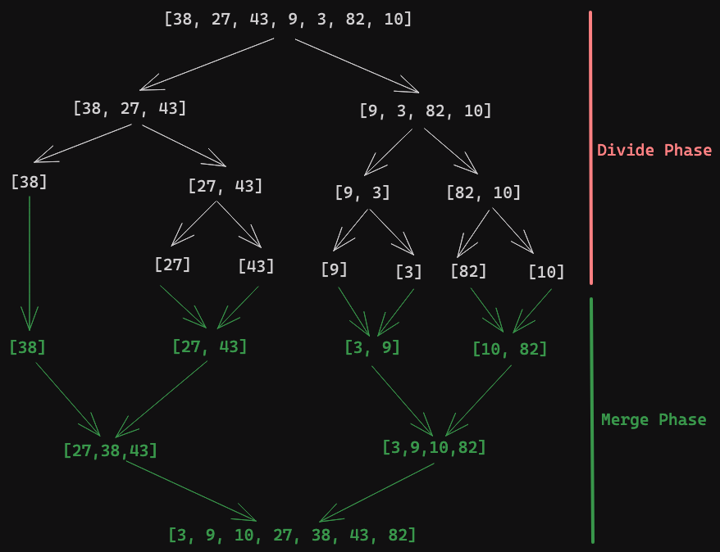
Merge Sort
In this sorting technique uses the method of divide and conquer technique.
In the dividing part the main array until each subarray only contains one element.
Then we enter the next phase of conquering where one sub array is compared with another and finally merged this process is done until we get the final sorted array

Slide 5
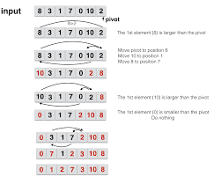
Quick Sort
Quick Sort also uses Divide and Conquer technique
It picks a pivot and partitions the array around the pivot element as all the elements left to it lesser than it and right to as greater than it.
This process is repeated after taking the elements on either side of the pivot as two new sub arrays.

Slide 6
Binary search:
Binary search is a searching technique that follows divide and conquer approach in which the list is divided into two halves, and the item is compared with the middle element on the list . If the middle element is the same as the number being searched then it will return else it will move the high to words left of the middle if the number being searched is less than the middle. And towards right if it moves the low towards its right if the number is more than middle.

Slide 7
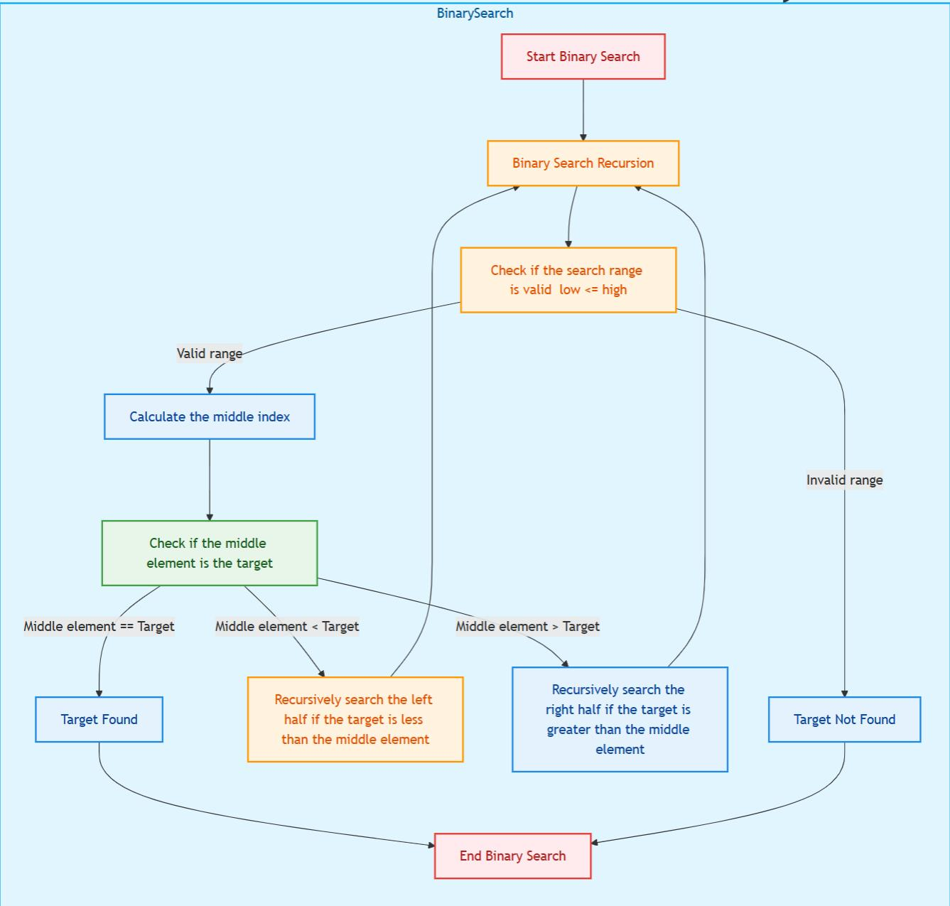
Flow chart for binary search

Slide 8
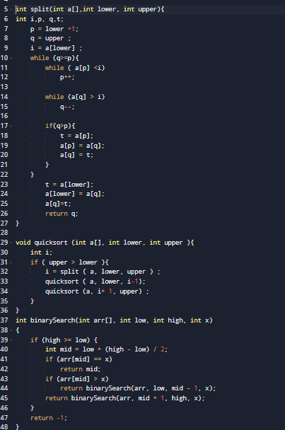
Code: quick sort

Slide 9
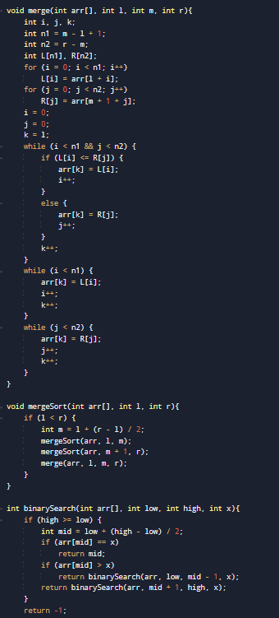
CODE: merge sort

Slide 10
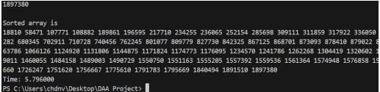
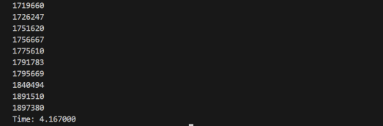
Merge sort vs Quick sort (input in ascending order input)

Slide 11
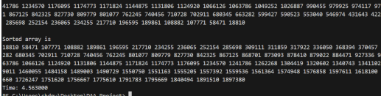
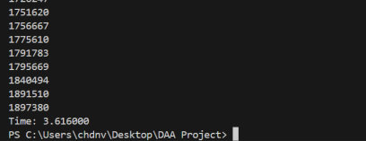
For descending order input

Slide 12
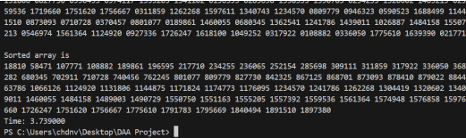
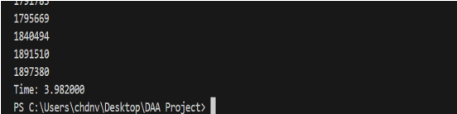
For unordered input

Slide 13
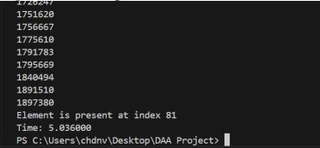
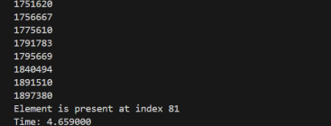
Merge sort and quick sort with binary search in different scenarios. For ascending order input

Slide 14
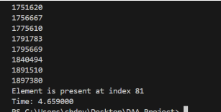
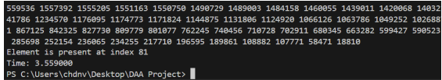
For descending order

Slide 15
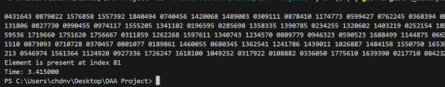
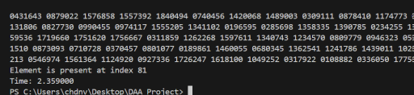
For random order

Slide 16
Differences?

Slide 17
Merge sort vs Quick sort
Merge Sort is steady, efficient, no matter how messy or organized data might be to start with.
It's slower than other algorithms sometimes, but you can always count on it to always do its job in an efficient manner.
Time complexity: O(n log n)
Quick Sort, on the other hand, is a bit of a risk-taker.
It's often faster, sorts data very quickly, but on rare occasions where it gets very unlucky by the random way the data was arranged (like the numbers were already in some sort of pattern), it really slows down.
While Quick Sort is usually the better faster choice, it's also less predictable than Merge Sort.
Time complexity: O(n logn)

Slide 18
Real time scenarios
E-commerce Platforms
Database Management
Search Engines
Financial Applications
Healthcare Data

Slide 19
Thank you, Any queries?

Slide 20
Done by
Praveen- AP23110010460
Aadarsh-AP23110010458
Likhitha- AP23110010469

